Slide 1
FIRST® LEGO ® League Challenge
Brown County FIRST Robotics Program
Robotic Training

Slide 2
Today’s Training Includes
Robot Building Basics
Size and Accessory Requirements
Start of design
Review of size/ maneuverability
Review of obstacles
What is the end goal
What is each’s scoring capability
Chance of Success
Design considerations
Stability
Driving Concepts
Access to main hub
Arms, bumpers, fenders
Sensors
Tricks to success
Operating the main hub
Connection to Bluetooth
On/Off
Charging
Program Progression
Plug connections
Robot Rule Books
Programing in Spike Prime
Season Progression
Competition Matches

Slide 3
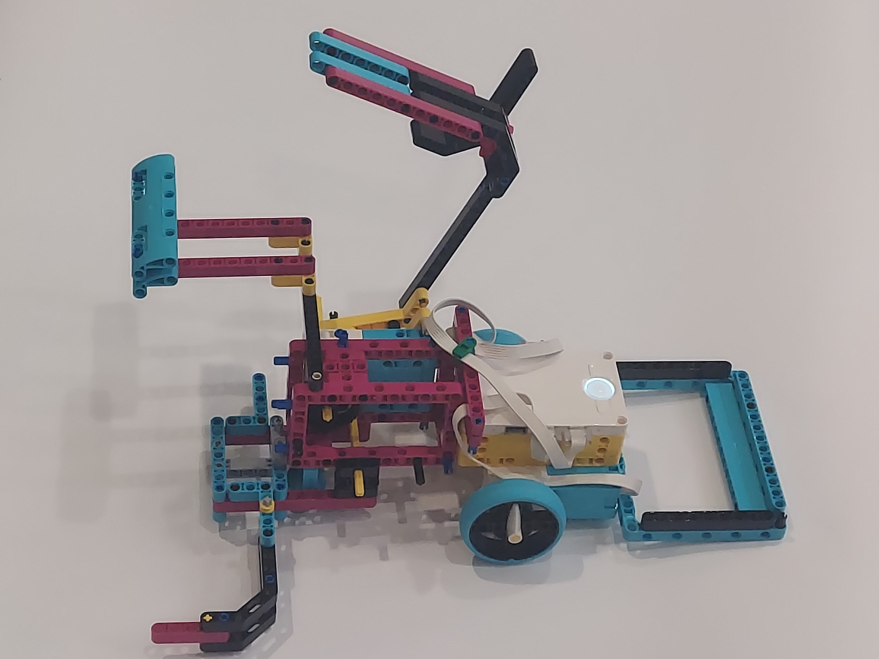
Robot Basics
Create a robot out of crates of parts
Max 4 Motors
Two Motors on the drive base
Two motors for “arms”
Max 3 Sensors
All Lego Parts
Max 12” x 12” x 12”
All parts, jigs, and add-ons must fit in home position
Program Robot to solve missions
2:30 on playing field
3 tries at the playing field (best score)
Everyone must program

Slide 4
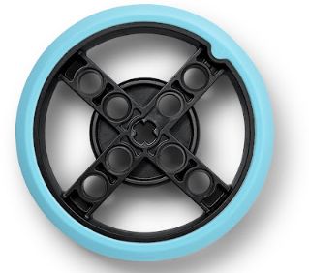
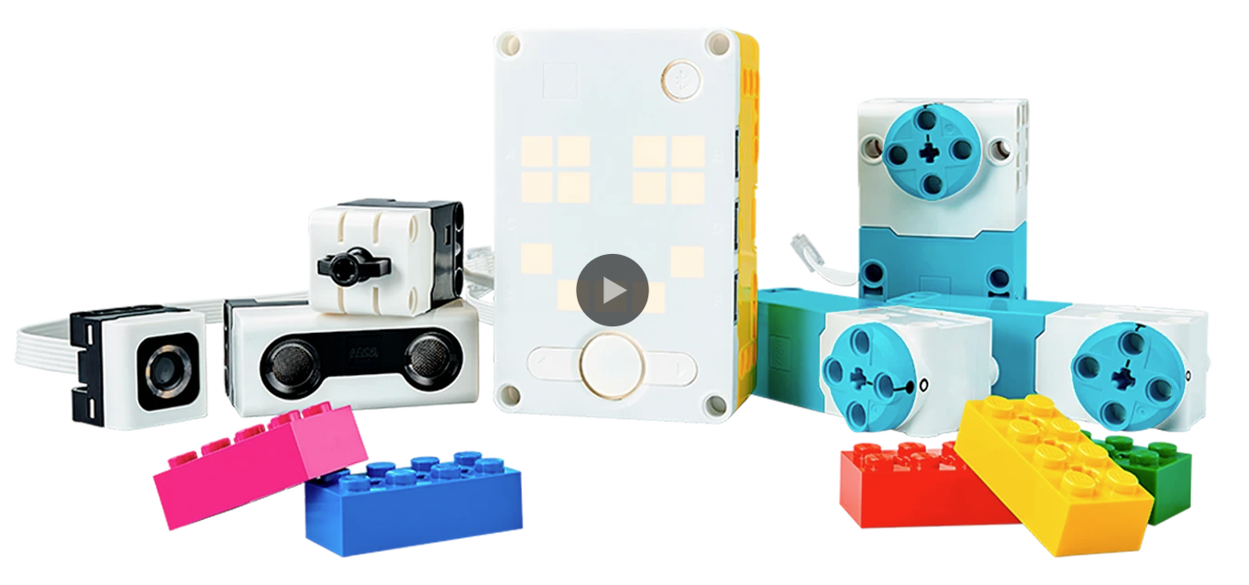
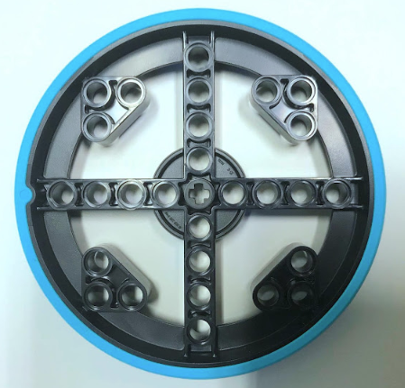
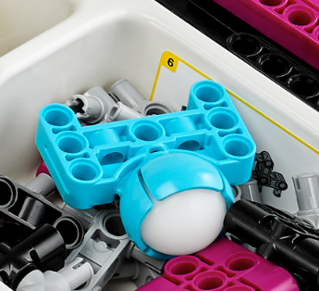
Robot Parts
LARGE MOTOR
ULTRASONIC
HUB
TOUCH
LIGHT/ COLOR
SMALL MOTOR
CASTOR

Slide 5
Robot Parts

Slide 6
The HUB
PRESS AND HOLD TO TURN OFF
PRESS AND RELEASE TO START AND STOP PROGRAMS

Slide 7
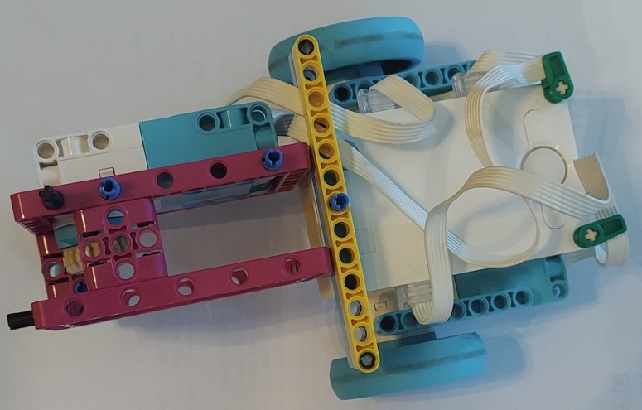
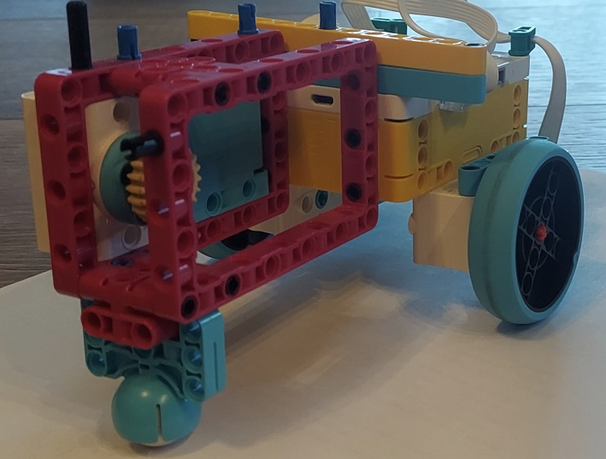
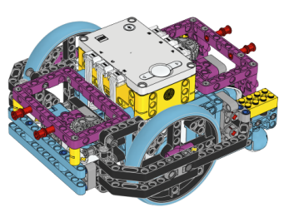
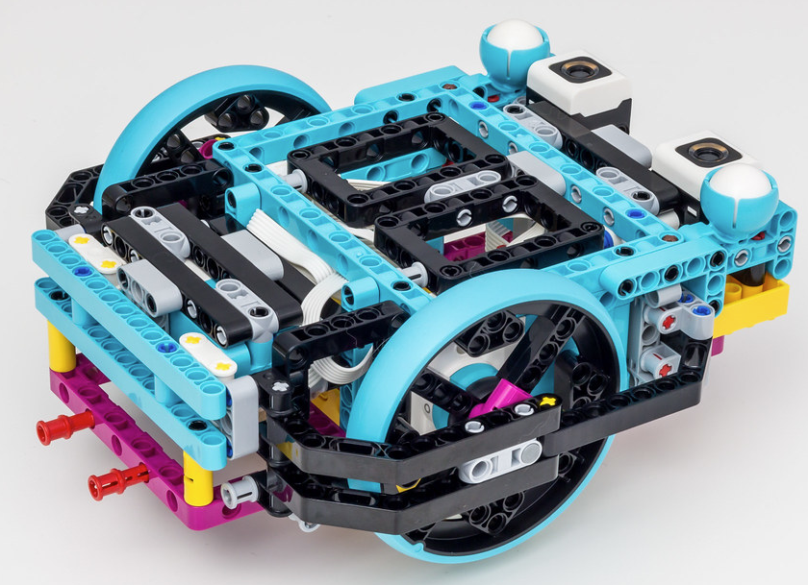
Robot Designs
Tri-bot
Two driving wheels and one caster
One arm motor
Advanced Base
Sensors, guards, two motors

Slide 8
Robot Concepts
Stability – A bouncing or twisting robot will never be accurate
There is no right or wrong solid design
Make sure your hub, ports and charging locations are accessible
Robot Base
Steering and Driving
Arms Designs
Fenders, Bumpers and Guards
Sensors

Slide 9
Meetings – Beginning of Season
Students learn about robot together for the 1st week or two of season
Understand the obstacles and scoring
Teach students basics in a larger group
Let them put together robots in small groups of 2-3 students
Focus on a strong base and designing in Rectangles
Try to keep better parts of any of the robots
The Tri-bot is a quick build to get your students programing
TWO robots ?

Slide 10
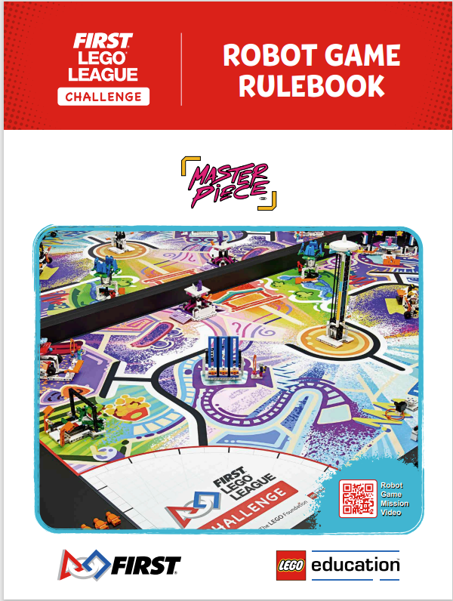
FLL - Resources
www.firstinspires.org/resources-library/fll /challenge/challenge-and-resources

Slide 11
Missions Video
https://www.youtube.com/watch?v=zI_vz9YUw1g
Notes:
https://www.youtube.com/watch?v=zI_vz9YUw1g

Slide 12
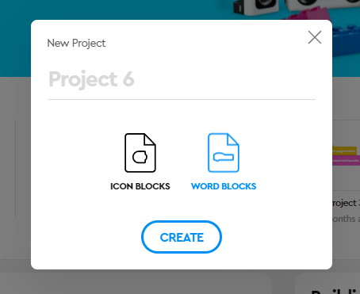
Programing with SPIKE Prime

Slide 13
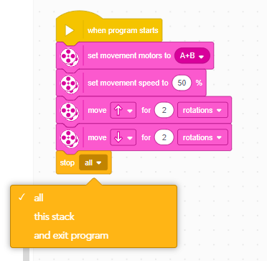
Programing Basics
Program starts
Set drive motors
Set speed
Begin Programing
Pink – Movement
Blue – Motor Movement
Dark Gold – Controls
Light Blue – Sensors
Green – Operators
End Program
Extension Blocks

Slide 14
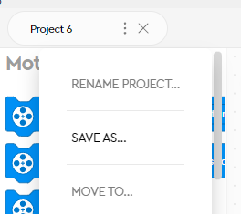
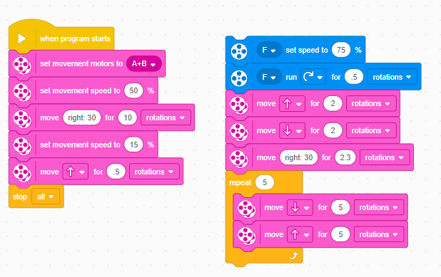
Programing
Renaming Programs
Programing in steps

Slide 15
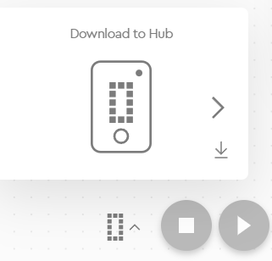
Connections to HUB
Bluetooth
Make sure Bluetooth is turned on the tablet and the robot
Numbering (up to 19 programs)
Downloading

Slide 16
Meetings – Mid Season (Weeks 3 – 6)
TEAMS NOW SPLIT UP – PROJECT (66%)/ROBOT (33%)
Robots
Base Robot has been designed by week 3
Students understand how to make it move around
Students begin programming in pairs with a programming mentor
Robot Starting Position and Jigs
Start the robot from the same position every time
Use Jigs

Slide 17
Meetings – End of Season (7-8)
Preparation of what has been completed
Core Values & Project
Students are performing their presentation to parents at the meetings
Parents should stay for a while and ask them questions (project or core values)
Robot Portion
ALL meetings end with 2:30 drills on the field for 30 minutes
After Week 6, the “Core” Robot should not be modified
PRACTICE COMPETITION – Manitowoc LREC
Dry Run of the teams with all Manitowoc County teams present (18 teams)
New teams will see how refined returning teams are
Add all students to the FIRST Roster (Firstinspires.org)
More information from Nic coming

Slide 18
Meetings – Students Mad Panic (9-10)
Practice Regional will highlight to students what areas they need to work on before the Regional Competition
Students learn new ways to complete certain obstacles
Students learn the way that they will be questioned by the judges
Students will see the fit/polish of veteran teams
Sometimes at practice competition we allow teams to follow through veteran teams

Slide 19
Regional Competition - Overview
10-12 Teams each Day at NWTC
Morning Activities – Judging
All Judging sessions – Project, Robot Design, and Core Values are held in one room
NOTES: Parents/Mentors allowed into the rooms but must remain absolutely silent or it counts against students. No hand signals.
Bring a way to show your programs

Slide 20
Regional Competition – Robot Design
Students have 5 minutes to explain their Engineering Design Process
May bring robot and attachments to show and support their discussion
Don’t be afraid to discuss failures or versions
Bring printouts of Programs from SPIKE PRIME software
If you need assistance with printing, please ask your lead mentor
Review the Rubrics
5 Minutes of questions from the judges
Judges like to see that everyone has answered a question which shows that all students were involved in the Robot Design and Programming
This part of Judging is used to ensure that students did the work. If we see a complex program and the students cannot explain it, or an attachment that they don’t understand, then it’s likely that they did not create it.

Slide 21
Regional Competition – The “Secret”
Only one team moves on SOLELY because of points scored on the field
Robot portion is used more to knock teams OUT of the competition
Must be in the top 50% (approx) of points scorers to move on
Several will move on because of how they did in the interview rooms
Judges are looking for teams that are well rounded in all three areas as well as the Robot Game portion of the competition

Slide 22
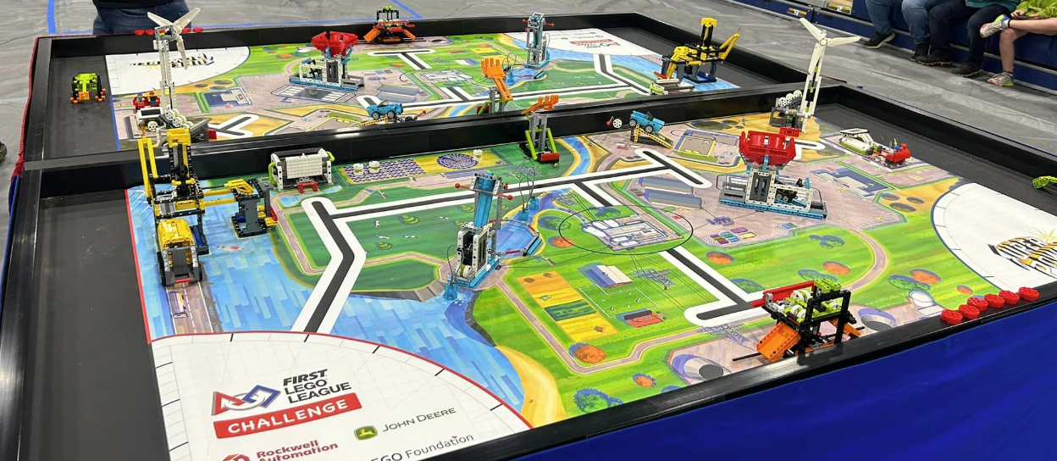
Field Competition
Two students are allowed at each home field at one time
Practice Tag-outs
All jigs, attachments, add-ons must be on the field
ONE ROBOT
No tablets are allowed at the table
Mentors are not allowed at the table

Slide 23
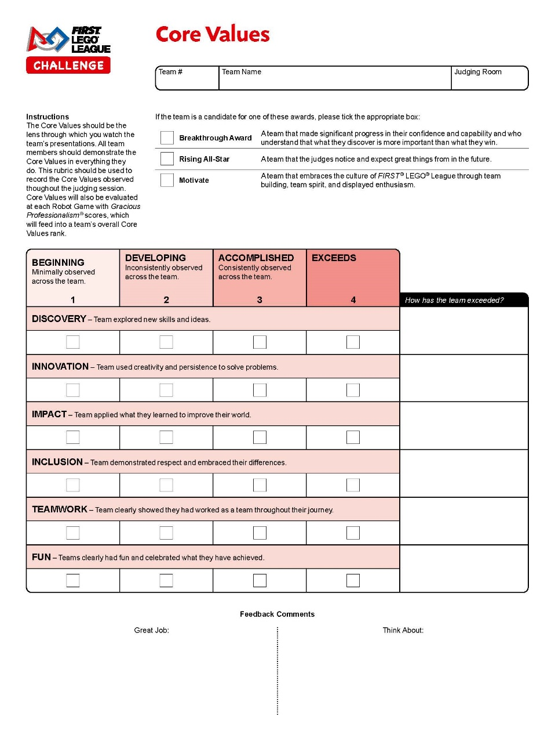
Rubrics – Core Values
The Core Values should be demonstrated by all team members in everything they do.
Judges will be completing this rubric to record the Core Values observed throughout the judging session.
Core Values will also be evaluated at each Robot Game with Gracious Professionalism® scores, which will feed into a team’s overall Core Values rank.

Slide 24
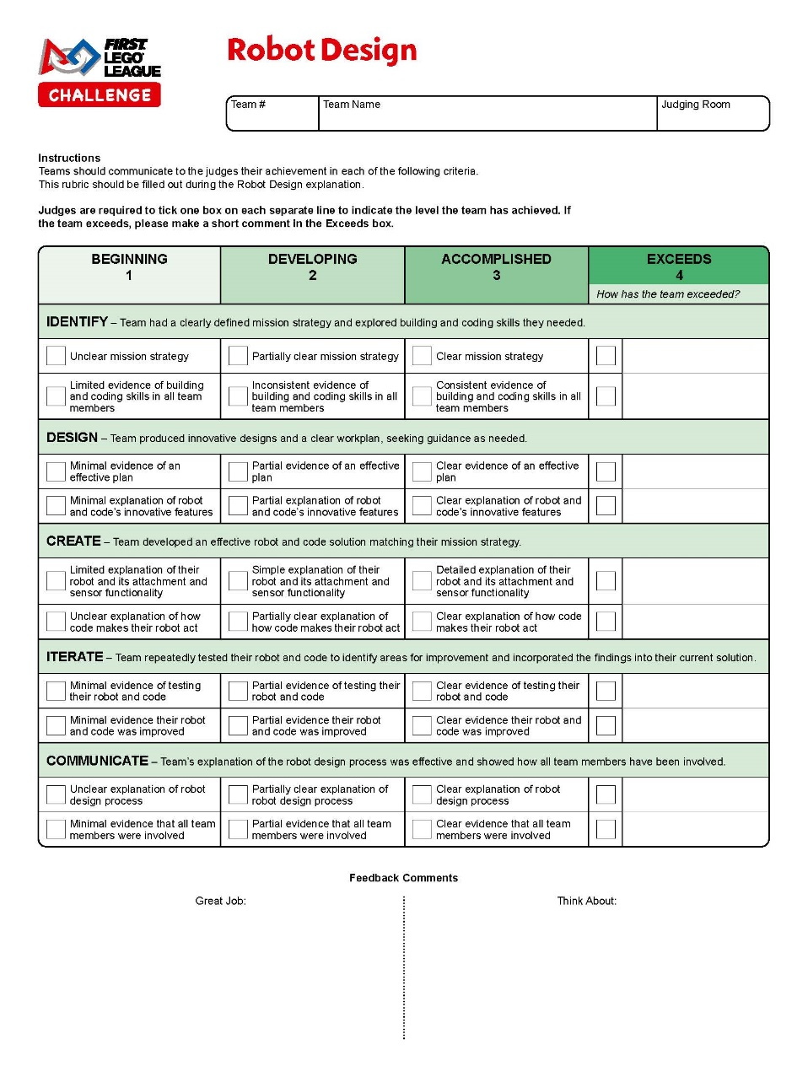
Rubrics – Robot Design
Students discuss their robot design decisions
Highlight multiple programs and iteration process
Students should talk through it with adults and must understand logic
Printed Programs in a binder are a plus (can list logic on sheet for students to reference)

