Slide 1
FIRST® LEGO ® League Challenge
Brown County FIRST Robotics Program
Mentor Training

Slide 2
Today’s Training Includes
What does it mean to be a mentor?
  Team Size
  Season
  Youth Protection Screening
Typical Meeting Flow
  Beginning of season
  Mid-season
  Near End
What to Expect at Competition
  Judging Sessions
    Innovation Project
    Robot Design
    Core Values
  Robot Games
    Covered more in-depth during robot training

Slide 3
Today’s Training Includes
Teamwork/Core Value
  What are they
  Why are they important
  Impact at competition
Teamwork Tasks
  Selecting Team Name
  Designing T-shirt
  Challenges during Meetings
Teamwork Rubrics
Project Side
  This year’s Challenge
  Selecting a Topic with students
  Research Topic/Sources
  Interviews
  Field Trips
Presenting at Competition
  30 Minutes in one Room with 3 -4 Judges
  How to prepare
  What to expect

Slide 4

Three Parts to FIRST LEGO League
Core Values
Project
Robot Challenge
  Robot Design
  Competition Matches

Slide 5
What does it mean to be a mentor?
Mentors guide students to learning
Mentors create a positive environment
Mentors reinforce good behavior
Mentors can and should have fun too

Slide 6

Core Values
Discovery: We explore new skills and ideas.
Innovation: We use creativity and persistence to solve problems.
Impact: We apply what we learn to improve our world.
Inclusion: We respect each other and embrace our differences.
Teamwork: We are stronger when we work together.
Fun: We enjoy and celebrate what we do!
Gracious Professionalism: We encourage high-quality work, emphasize the value of others and respect individuals and the comunity
Coopertition: All teams should do their best to assist and work with each other, even if you’re competing against them.

Slide 7
Team Size/Dynamics
Students - Grades 4 through 8
Teams can range from 6 to 10 students (We limit at 8 students)
Age and Personality Ranges – Watch during first meetings to best group
Some students only want to program & others only want project
  ALL NEED TO BE INVOLVED IN BOTH TO SOME DEGREE or it will come out in the questioning at competition

Slide 8
Meeting Expectations
Legos no fly – Legos no crash
Leave the space better than you found it
  All spaces must be cleaned up prior to anyone being dismissed
Each member must program, build and research
Respect each other’s space, views, opinions and ideas –
  Be open to new ideas
Discuss ideas as a group – review pros and cons as a group in a positive manor
Spend approx. ½ your time programing/building and ½ time researching - Take turns
Teasing, bullying and rough housing will not be tolerated
HAVE FUN!!!!!!!

Slide 9
Meeting Times
Approx 5 hours per week (It’s OK to assign homework)
Younger students’ attention span is typically 2 hours
  Older students can sometimes handle 3 hours especially heading to State
10 minute break
  Great switch off point

Slide 10
Meetings – Beginning of Season
Challenge Obstacle Kit Build – Usually the first task
Team Building
  Fun discussions about silly team name
  Discuss/draw what they would like on their t-shirts (generally ties into topic)
    T-Shirt Orders are due by October 1st
  Finish putting together any obstacles
Project Selection
  Basic Research as a group to get a handful of ideas
  Begin brainstorming specific ideas
  Put them on a white board and have students vote/narrowing down to 1
Students learn about robot together for the 1st week of season
  Understand the obstacles and scoring
  Teach students basics in a larger group
    Let them put together robots in small groups of 2-3 students
    Focus on a strong base and designing in Rectangles
    Try to keep better parts of any of the robots

Slide 11

FLL How to:
What is the Challenge?

Slide 12


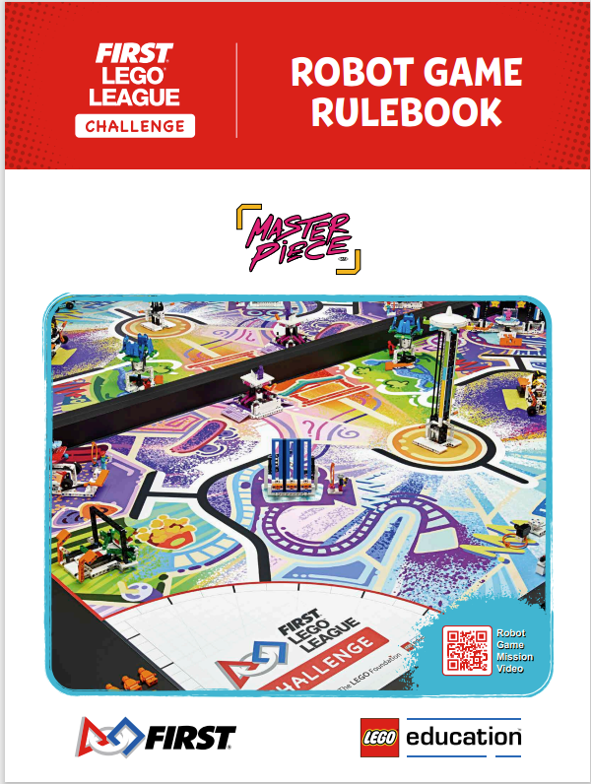
FLL - Resources
www.firstinspires.org/resources-library/fll /challenge/challenge-and-resources

Slide 13
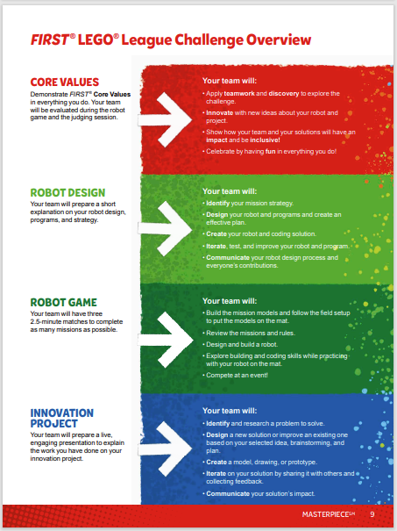
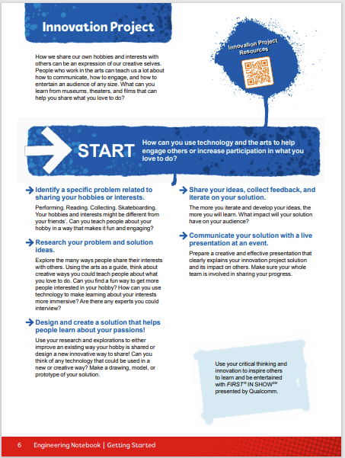
FLL - Resources
www.firstinspires.org/resources-library/fll /challenge/challenge-and-resources

Slide 14
What is the Project
Teams must
  Research the topic
  Find a specific problem they’re interested in
  Create an INNOVATIVE Solution on the challenge
  Create a 5 minute presentation for the judges
  Present it at the tournament
Team should
  Speak to a professional in the field
  Share with the community
GOAL
  To get students to think about careers they never knew existed
  To show students they can change the world – even at a young age

Slide 15
Innovation Project
How we share our own hobbies and interests with others can be an expression of our creative selves. People who work in the arts can teach us a lot about how to communicate, engage and entertain an audience of any size. What can you learn from museums, theaters and films that can help you share what you love to do.
START - How can you use technology and the arts to help engage others or increase participation in what you love to do.

Slide 16
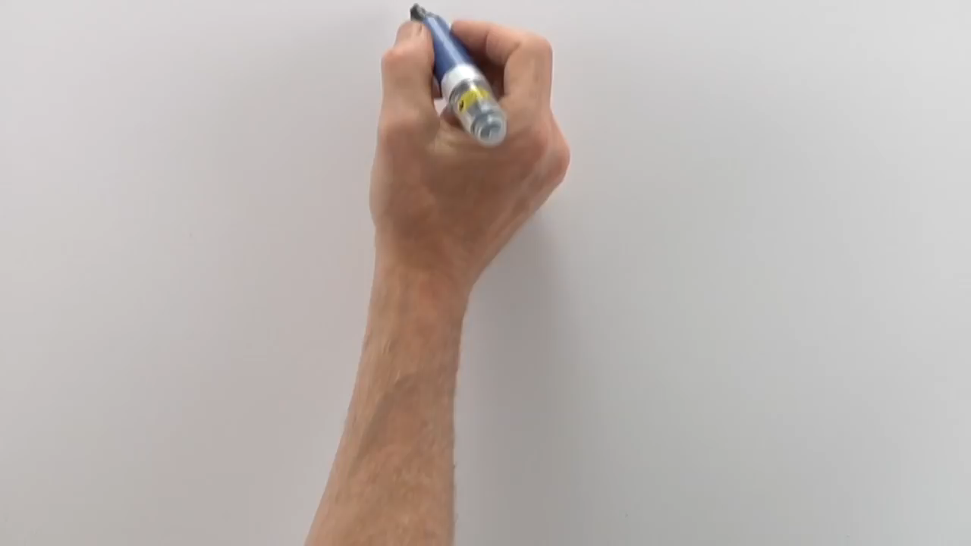
FLL How to:
How to have a Successful Project Experience

Slide 17
Meetings – Mid Season (Weeks 3 – 6)
TEAMS NOW SPLIT UP – PROJECT (66%)/ROBOT (33%)
Swap at Snack time or at an interval so everyone gets to program
Project/Core Values
  Students understand the topic that they have chosen
  Week 3 or 4 - Team has designed team t-shirt & Voted
  Gathering information as a team & beginning to create skit/presentation
  Students creating Trifold/Presentation for Table
Robots
  Base Robot has been designed by week 3
  Students understand how to make it move around
  Students begin programming in pairs with a programming mentor

Slide 18
Helping kids research
What makes a research source valid
Make sure all ideas are shared and valued
Determining your topic
  Popular vote
  Common connections among team members
  Most available resources/ connections
  Who is going to benefit from this idea
Discuss your presentation methods
Assign kids research for the weekends –
  Use this as a means to communicate to your parents what is going on in the program

Slide 19

FLL How to:
How to Present your Project!

Slide 20
Project Presentation
Ways to Present Your Project
  Skits
  Songs
  Tri-fold presentation boards
  Models of concept
  Videos or recordings
  Team Themes
Parts of the Presentation
  Project
  Robot and Programing
  Core Values

Slide 21
Meetings – End of Season (7-8)
Preparation of what has been completed
  Core Values & Project
    Students are performing their presentation to parents at the meetings
    Parents should stay for a while and ask them questions (project or core values)
  Robot Portion
    ALL meetings end with 2:30 drills on the field for 30 minutes
    After Week 6, the “Core” Robot should not be modified
PRACTICE COMPETITION – Manitowoc LREC
  Dry Run of the teams with all Manitowoc County teams present (18 teams)
  New teams will see how refined returning teams are
Add all students to the FIRST Roster (Firstinspires.org)
  More information from Nic coming

Slide 22
Meetings – Students Mad Panic (9-10)
Practice Regional will highlight to students what areas they need to work on before the Regional Competition
  Students learn new ways to complete certain obstacles
  Students learn the way that they will be questioned by the judges
  Students will see the fit/polish of veteran teams
    Sometimes at practice competition we allow teams to follow through veteran teams

Slide 23
Regional Competition - Overview
10-12 Teams each Day at NWTC
Morning Activities – Judging
  All Judging sessions – Project, Robot Design, and Core Values are held in one room
NOTES: Parents/Mentors allowed into the rooms but must remain absolutely silent or it counts against students. No hand signals.
Bring a way to show your programs
Bring “Bribes” – goodies and treats so judges remember you

Slide 24
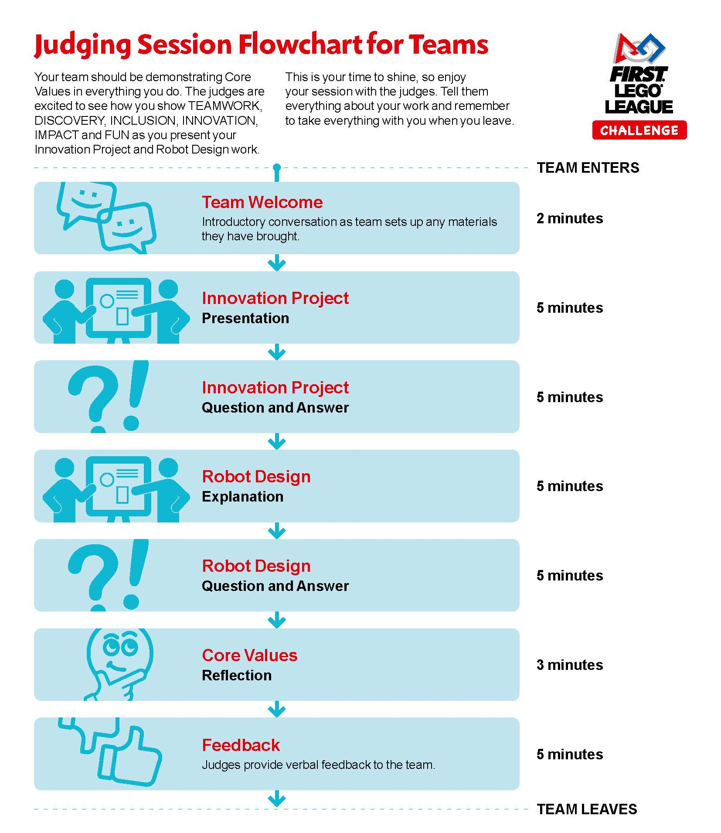
Regional Competition - Overview

Slide 25
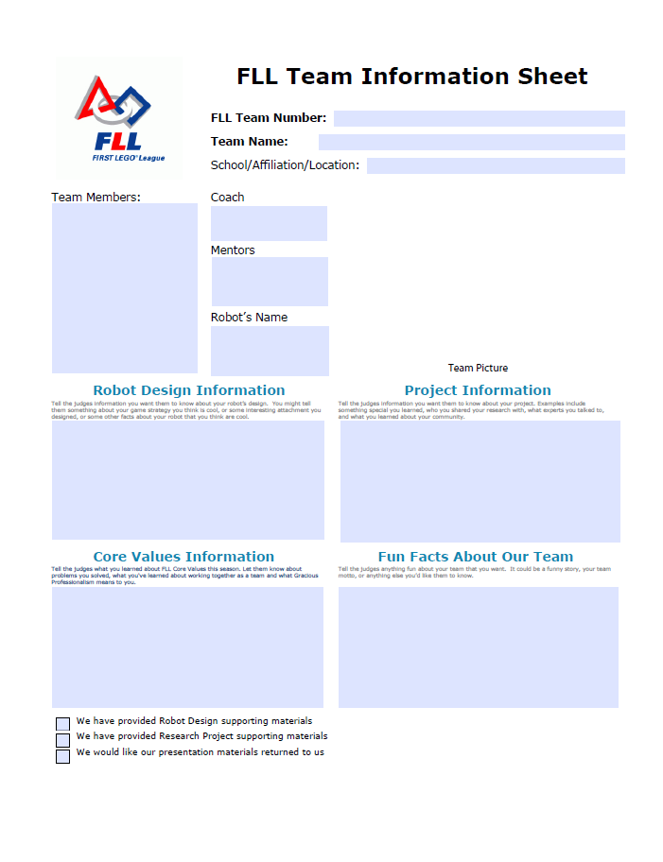
Team Information Sheet
Reminds the judges of who you are
Complete everything for the judges
Have students write with your assistance
MAKE YOUR TEAM STANDOUT

Slide 26
Regional Competition – Innovation Project
Students are judged on presentation and the originality of the solution that they created
  DO NOT JUST RESEARCH A TOPIC Develop an INNOVATIVE SOLUTION
Tips for the Presentation
  5 Minutes total
  Enter with great attitude/smiles (kids carry that through their presentation)
  Visual Aids Help & and students can leave judges with handouts/Info
  Review the Rubrics
5 Minutes of questions from the judges
  Judges like to see that everyone has answered a question

Slide 27
Regional Competition – Robot Design
Students have 5 minutes to explain their Engineering Design Process
  May bring robot and attachments to show and support their discussion
  Bring printouts of Programs from SPIKE PRIME software
    If you need assistance with printing, please ask your lead mentor
  Review the Rubrics
5 Minutes of questions from the judges
  Judges like to see that everyone has answered a question which shows that all students were involved in the Robot Design and Programming
This part of Judging is used to ensure that students did the work. If we see a complex program and the students cannot explain it, or an attachment that they don’t understand, then it’s likely that they did not create it.

Slide 28
Regional Competition – Core Values
Judges will be assessing how the team displays the Core Values throughout the Project Presentation and Robot Design Explanation
Judge will ask questions to determine areas where they didn’t see examples during the Project Presentation and Robot Design Explanation
  Primarily about who leads, how did they break up the tasks, do they all get along, how did they make tough decisions, etc.
  Review the Rubrics
  Know your Core Values
  Know what FIRST Stands for & Who Dean Kamen and Woody Flowers are!!!
  Keep smiling & having fun with the judges

Slide 29
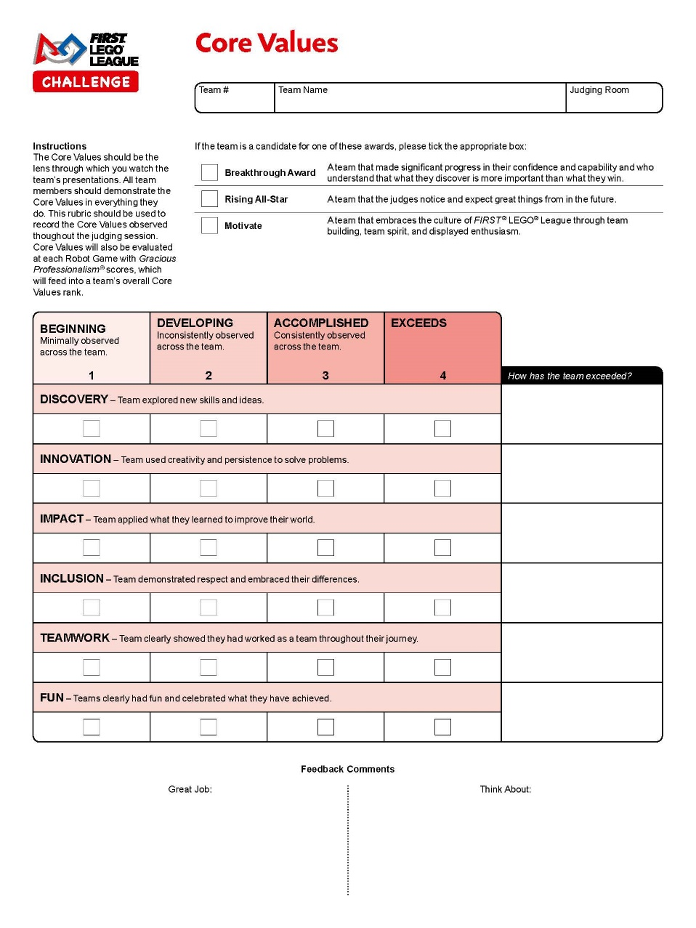
Rubrics – Core Values
The Core Values should be demonstrated by all team members in everything they do.
Judges will be completing this rubric to record the Core Values observed throughout the judging session.
Core Values will also be evaluated at each Robot Game with Gracious Professionalism® scores, which will feed into a team’s overall Core Values rank.

Slide 30
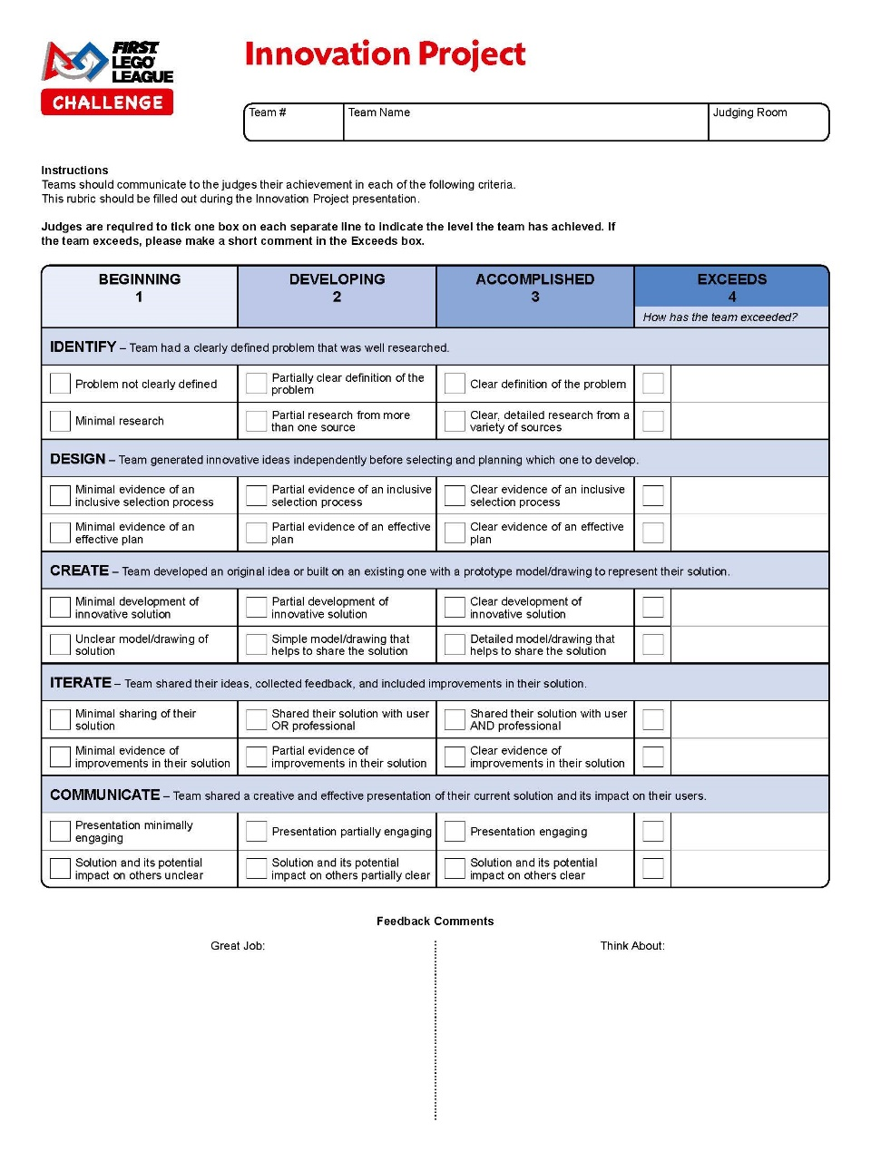
Rubrics – Innovation Project
Emphasize a UNIQUE SOLUTION
Number of Sources (not just Google)
Field Trips and Professionals a big plus
Sharing your unique solution
Reiteration
Follow the Engineering Design Process

Slide 31
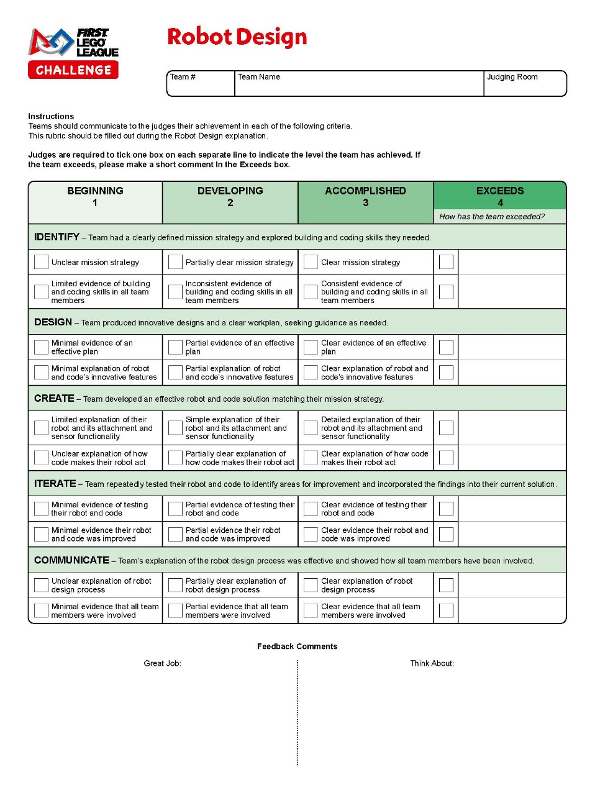
Rubrics – Robot Design
Students discuss their robot design decisions
Highlight multiple programs and iteration process
Students should talk through it with adults and must understand logic
Printed Programs in a binder are a plus (can list logic on sheet for students to reference)

Slide 32
Any Questions?
nkaufmann@browncountyfirstrobotics.org
arrow@lakeshorefirstrobotics.org

